Slide 1
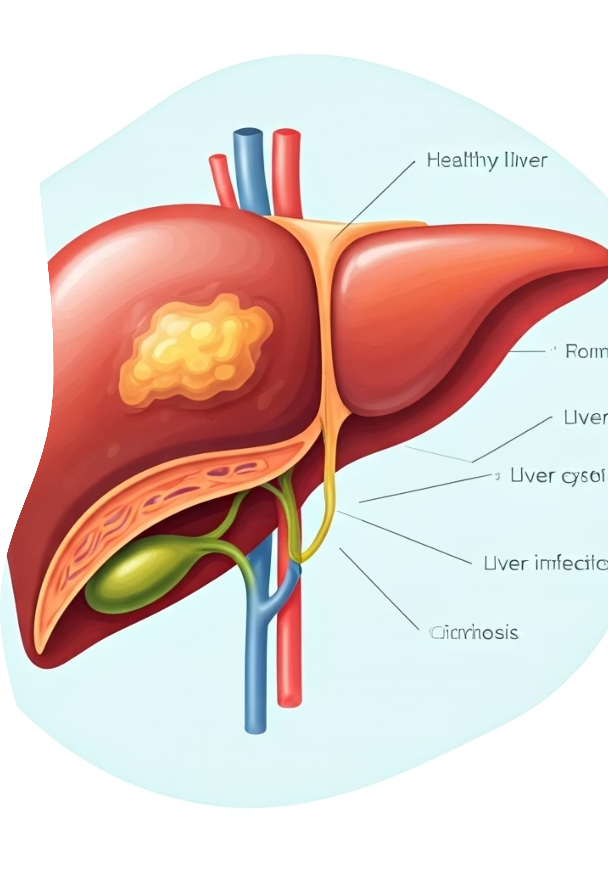

MRI & CT Scans for Liver
Why are MRI and CT scans done for the liver?
Doctors use MRI and CT scans to take detailed pictures of the liver to find problems such as:
Fatty liver
Tumors or cancer
Cysts or infections
Liver damage or cirrhosis
Blockage in liver blood vessels or bile ducts
These scans help doctors see inside the body without surgery.
by Ram N Java

Slide 2
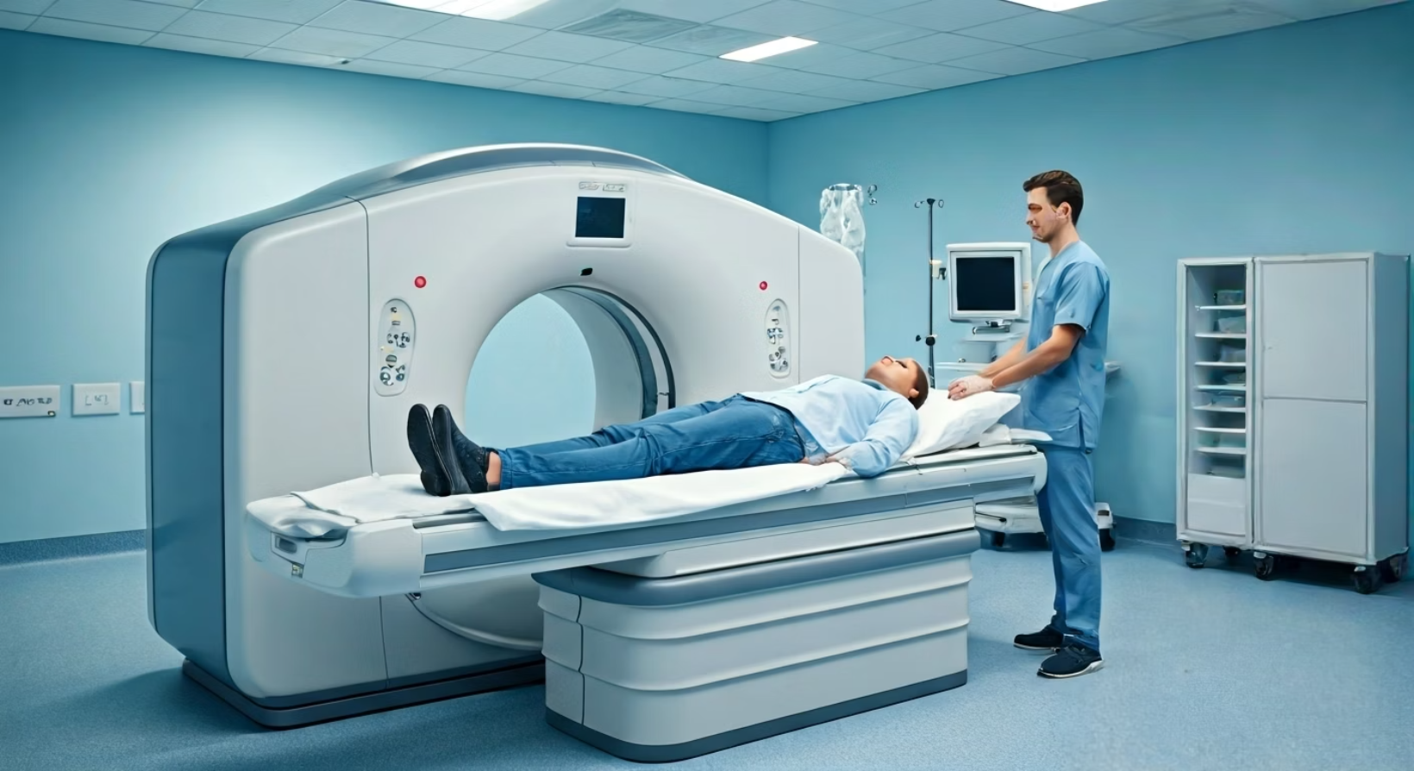
What is a CT Scan?
A CT (Computed Tomography) scan uses X-rays to take many pictures of your liver from different angles.
A computer joins these images to make a clear 3D picture of the liver.
It helps find tumors, injuries, or liver swelling.
How it feels:
You lie on a bed that goes inside a big round scanner.
You may get an injection of contrast dye to see the liver more clearly.
It usually takes about 10 to 15 minutes.
It is painless, but you need to stay very still.

Slide 3
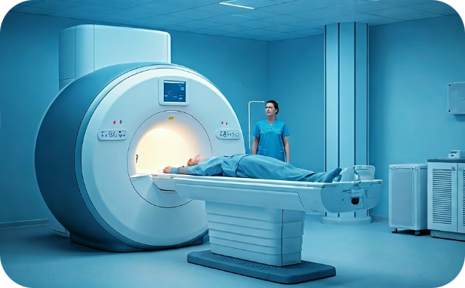
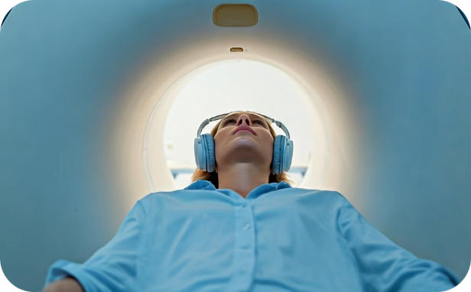
What is an MRI Scan?
MRI Technology
The MRI Experience
An MRI (Magnetic Resonance Imaging) scan uses strong magnets and radio waves (not X-rays) to make detailed pictures of the liver.
You lie on a bed that moves into a long tube-like machine.
The machine makes loud sounds (earplugs or headphones are given).
You may get an injection of contrast dye.
It shows soft tissues, blood vessels, and abnormal growths more clearly than a CT in some cases.
It takes about 30 to 45 minutes.
It is safe and painless, but you must stay still.

Slide 4
Difference Between CT and MRI for Liver
Feature
CT Scan
MRI Scan
Technology
Uses X-rays
Uses magnets and radio waves
Time taken
10–15 minutes
30–45 minutes
Detail level
Good for basic liver problems
Better for soft tissue and tumors
Radiation
Yes (low level)
No radiation
Cost
Usually less costly
Usually more costly

Slide 5

Preparation and Safety
Do I need to prepare?
Is it safe?
You may be asked to not eat or drink for a few hours before the scan.
Tell the doctor if you:
Are pregnant
Have kidney problems
Have metal implants or pacemakers (MRI may not be allowed)
Yes, both are safe when done under medical advice.
MRI is safer for long-term use because it does not use radiation.

